Slide 1


Automated Elephant Detection and Early Warning System
AI in
Group 4
Chen Jun Han
Cheng Jing Siang
Wong Zhi Xuan
Lim Kuan Ming
[20409166]
[20409588]
[20393574]
[20413703]

Slide 2
Background
Deforestation, urbanization, and climate change are rapidly destroying natural habitats, putting many species at risk of extinction.

Slide 3

The Growing Problem of Human-Elephant Conflict
Destruction of crops and property
Elephants often enter farmlands in search of food, trampling and consuming crops, damaging fences, storage, and even homes, leading to significant economic loss for rural communities.
Threats to human safety
Close encounters with elephants, especially at night or during migration periods, can lead to injuries or fatalities, creating fear and tension among local residents.
Monitoring Challenges
Dense vegetation and limited infrastructure make it hard to track elephants using traditional methods, delaying warnings and preventing timely interventions.

Slide 4
Objectives:
Aiming for a Sustainable Solution
Automated Elephant Detection
Real-time Warnings
The system automatically detects elephants through camera and audio data using machine learning,.
The system sends immediate notifications to nearby communities, allowing proactive measures to avoid human-elephant conflicts.
Sustainable Operation
Easy Deployment
The system operates on green energy, ensuring sustainable power without the need for direct electricity connections.
The system is designed for easy setup and low-maintenance operation, perfect for remote and off-grid locations.

Slide 5



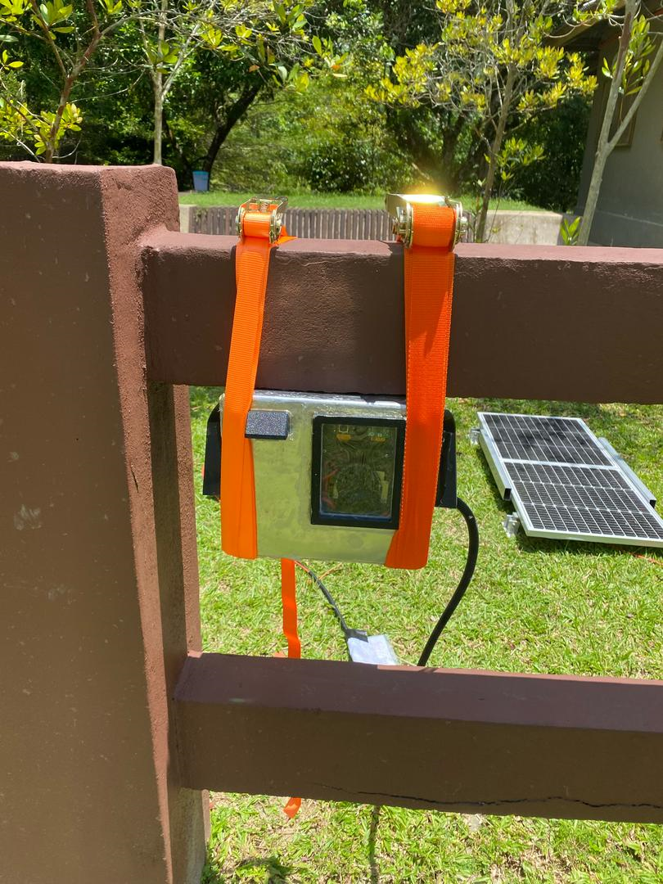
Elephant Detection Approach
🔍
Combines visual and bioacoustic sensors for reliable elephant detection.
Dual Mode Detection
🔋
Solar-powered in remote areas, no external electricity required.
OFF-Grid Operation
🧠
Machine learning runs locally on the device, without the need for cloud connectivity..
Edge Processing
☁️
Instant data transmission via API for live monitoring and alerts.
Real-Time API
⚙️
Easy installation and operation, designed for user-friendly interaction without technical complexity.
Plug and Play
🌧️
Weather Resistance
Designed for durability, able to function in tough environments with varying climates.

Slide 6
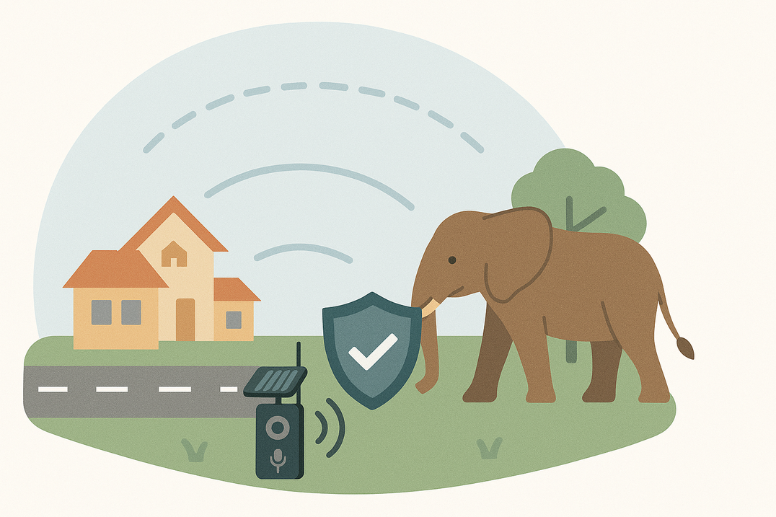
A Path to Coexistence
Early Detection
Warns communities before elephants get too close
Safety for All
Prevents injuries and protects property
Empowered Communities
Supports peaceful living near elephant habitats

Slide 7
Key Features of the System
Deforestation, urbanization, and climate change are rapidly destroying natural habitats, putting many species at risk of extinction.

Slide 8
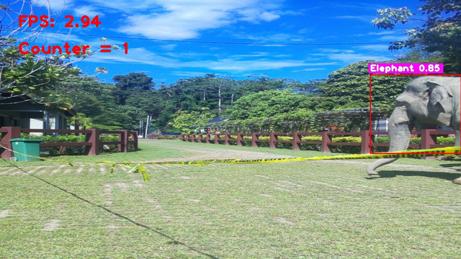
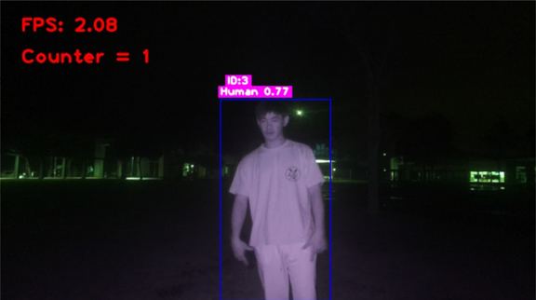
Image Detection
High Accuracy on Elephants Detection
Able to Detect Other Wildlife/Objects
YOLO-based image detection model.
Trained with large dataset of elephant image.
Car
Cow
Human
Motorbike
Sheep
With moderate accuracy.
Capture & Annotate Images
High resolution
Workable during day and night
Box annotated for detected objects
Tracking ID, name and confidence level
Counter and FPS

Slide 9
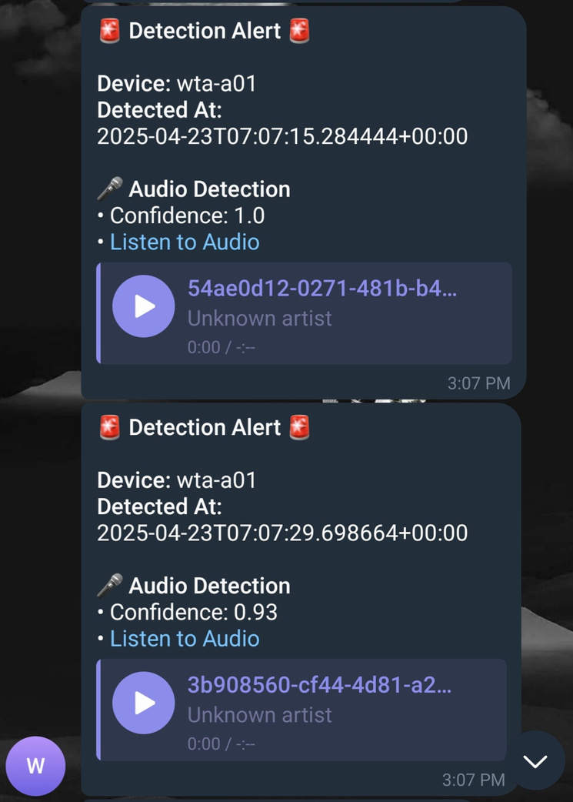
Audio Detection
High Accuracy on Elephant Detection
PyTourch-based audio detection model.
Detection model trained with a large dataset of elephant sounds.
Audio Recording
Record 4s audio when elephant sound is detected
Name, confidence level and timestamp
Multiple Detection Events
Elephant
Gunshot
Background noise

Slide 10
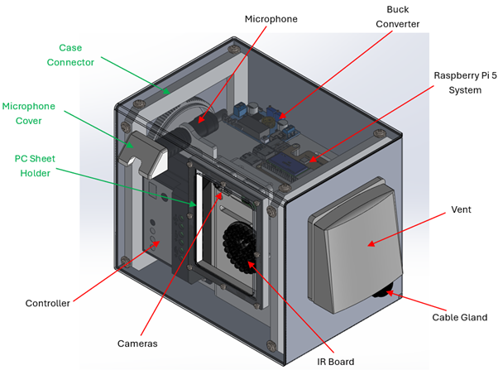

Case Design
Weatherproof
Robust & Lightweight
Ease of Maintainence
Waterproof.
Corrosion resistance.
Impact resistance.
Aluminium outer case.
3D-printed inner holder.
Compact.
Mounted with a cargo strap.
Modular design.
Quick access to internal components by unscrewing front cover’s bolts.
Simplified assembly and disassembly process

Slide 11
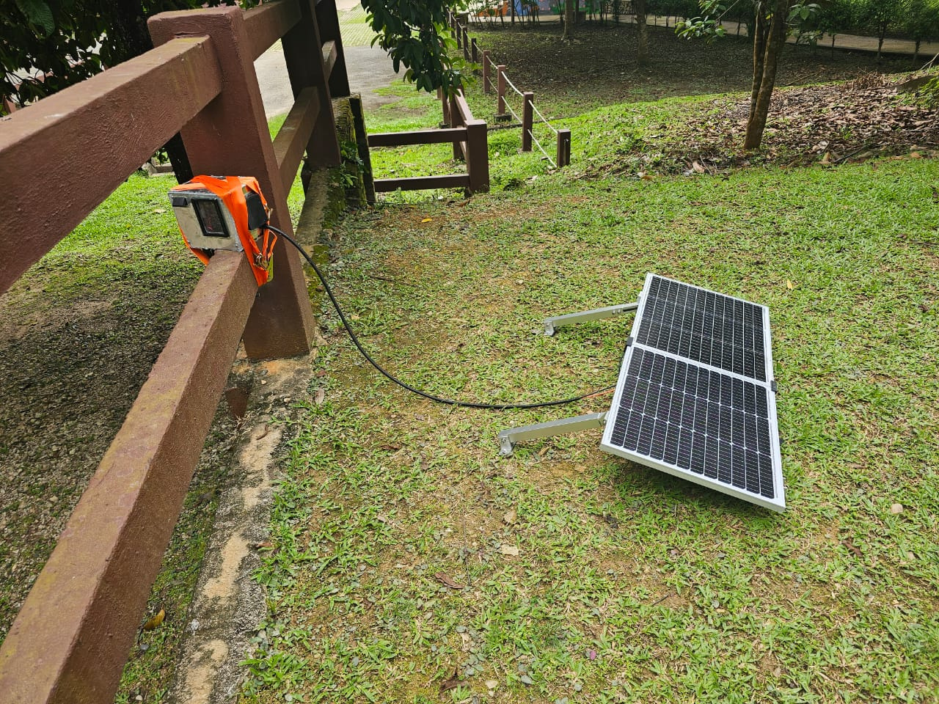
Power Management System
Solar Powered
Large Battery Capacity
100W solar panel.
Battery recharge during daytime.
18Ah battery capacity.
Power Management
Solar charge controller
Automatically turns off the system when the battery is too low
Turns back on when the battery recharges to a safe level

Slide 12
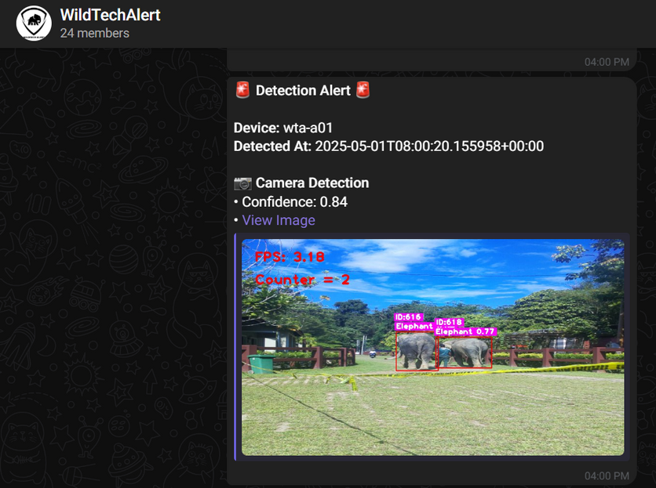
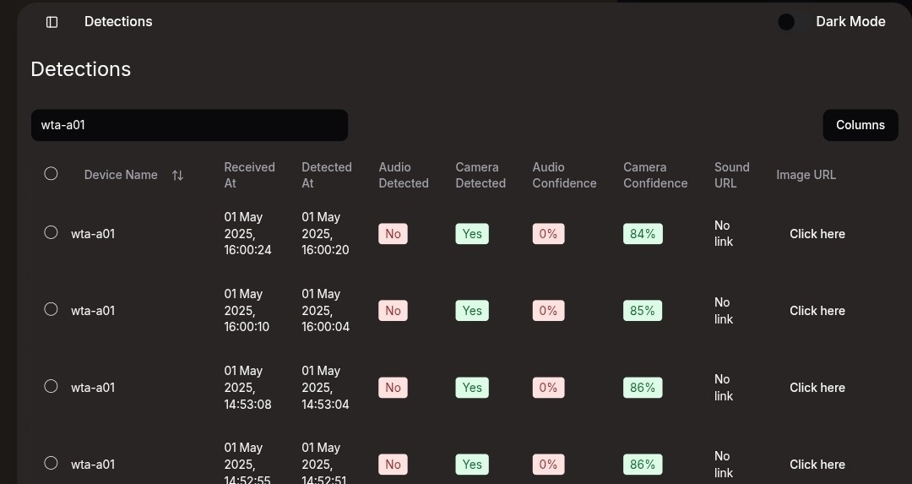
Alert and Logging
Live on Telegram
Access through Website
Logging System Locally
Notification
Live updates
Detection data.
Timestamp
Handshake
Data protection
Save unsent data.
Error Logging
Ease debugging

Slide 13

System Performance
Deforestation, urbanization, and climate change are rapidly destroying natural habitats, putting many species at risk of extinction.

Slide 14
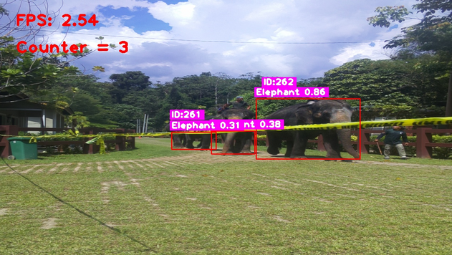


Detection Accuracy
Image Detection Accuracy
Audio Detection Accuracy
Achieved 95% accuracy in identifying elephants using a self trained model.
Scored 92.33% of accuracy using a deep learning-based audio recognition system.
Elephant sound detection result:
Gunshot sound detection result:
Combined Results
Effective integration of audio and image detection reduced false positives and provided robust early warnings.

Slide 15
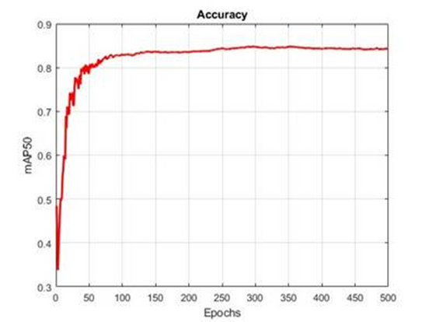
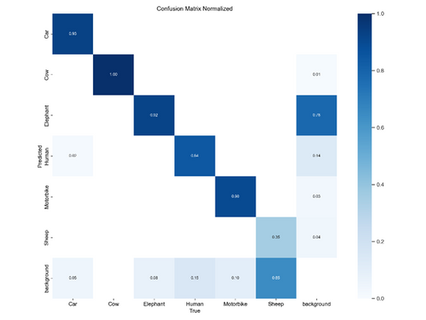
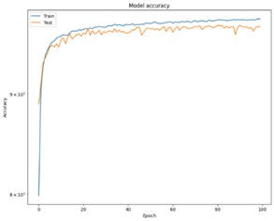
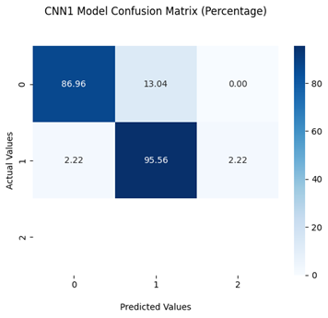
Model Training Accuracy
Image Detection Model
Audio Recognition Model
Final Accuracy: 95% for elephants
Stabilized after 350 epochs
Some false positives detecting humans as elephants (0.75 confusion rate) based on Confusion Matrix
Best Setup: 100 epochs with augmented dataset
95.56% Elephant Detection
86.96% Noise Detection percentage

Slide 16
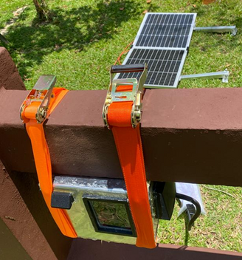

Power Uptime
Solar-Powered System
Two 50W solar panels generate approximately 600 Wh/day under peak conditions, contributing to recharging the battery for the next cycle.
Charging Duration
Charging Power
The battery would take approximately 4 to 5 hours to charge under peak sunlight, accounting for panel efficiency.
The solar panels generate enough power during peak sunlight to recharge 80% of the battery by evening.
API Handshake
Battery Uptime
The system achieves 16-18 hours of runtime, combining solar input and battery storage. This is sufficient for continuous operation until midnight. The API Handshake log is observed for a week to justify this.
The API handshake logs demonstrate consistent operation throughout the runtime

Slide 17


Connectivity
4G LTE Module
API Integration
Challenges and Solutions
Enabled real-time data transmission via cellular networks, ensuring prompt alerts
Seamless connection with a centralized monitoring system, accessible from anywhere with internet connectivity.
Overcame signal interference by optimizing the 4G dongle’s placement within the casing.

Slide 18



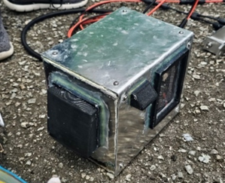
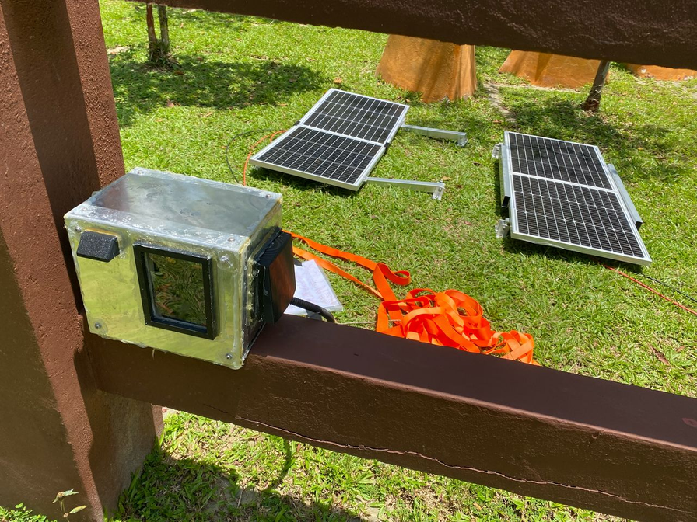

Casing
for supporting long-term field deployment in outdoors
Material Selection
Durability
Thermal Management
Weatherproof aluminium casing (6061-O alloy) combined with PETG 3D-printed inner holders.
Waterproof and impact-resistant design tested under simulated field conditions
Ventilated design and cooling system to prevent overheating, ensuring component longevity
Final Casing Assembly

Slide 19
Challenges
Deforestation, urbanization, and climate change are rapidly destroying natural habitats, putting many species at risk of extinction.

Slide 20
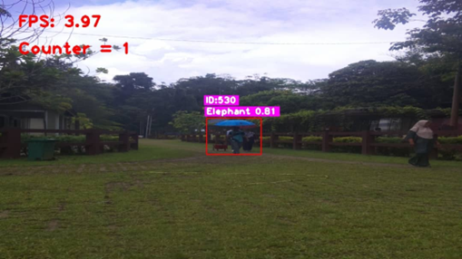
Detection Error
Protecting our Planet
False positives in image detection
Human detected as elephant
Posture resembling elephant shapes
Large Size or backpacks
Dark Clothing confuse the model
Audio detection challenges
Shotgun microphone struggles to pick up distant or off-axis elephant calls
Elephants rarely vocalize; detection window is small
Detection success depends heavily on mic placement and environmental noise

Slide 21

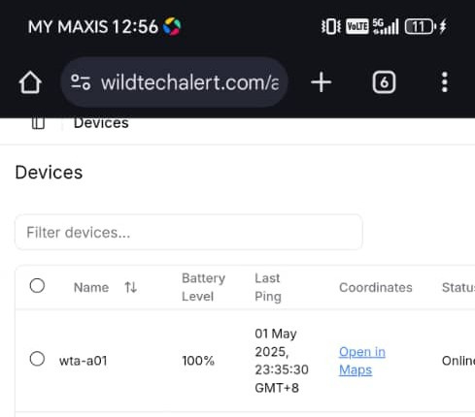
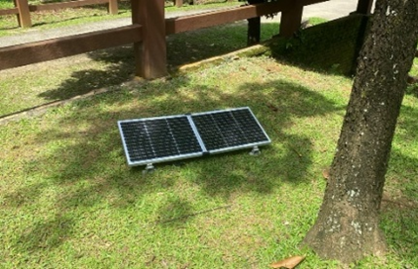
Hardware Constraints
Power supply limitation
Device often shuts down during night due to insufficient daytime solar charging
Rainy or cloudy weather affects solar panel efficiency, leading to early deactivation
System depends heavily on solar charging conditions
Satellite Monitoring
Casing limitations
The bent metal casing introduces slight inconsistencies at the sealing edges. These gaps can reduce waterproof reliability.
Manufacturing tolerances lead to gasket misalignment
The current microphone housing effectively blocks rain. However, it limits audio sensitivity.
Satellite Monitoring

Slide 22
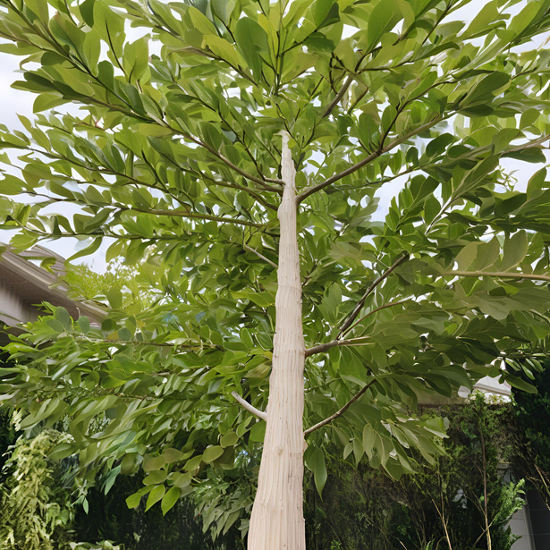

Deployment Constraints
Tree mounting restrictions
Fixed installation point
No Remote access
Casing cannot be securely tied to narrow or irregular trees
Current cargo straps interfere with camera and vent positioning
Limits flexibility and quick deployment in the field
Once installed, repositioning is difficult
Placement of camera and vents restricts strapping angles
Can interfere with field-of-view or airflow

Slide 23


Connectivity Issues
Unreliable Connection
Manual Intervention Needed
Impact on API Communication
4G dongle experiences intermittent drops in rural zones
Signal fluctuations lead to lag or delayed API updates
Occasional dongle disconnection requires physical reconnection
Limits fully autonomous operation

Slide 24
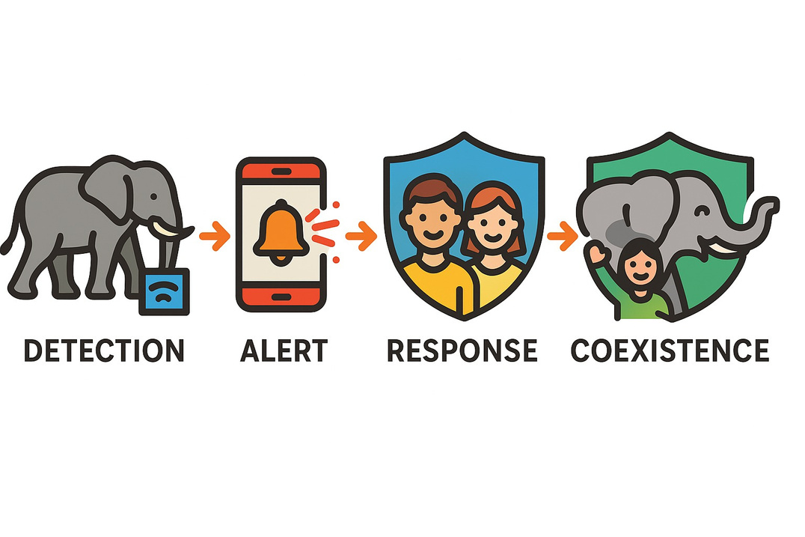
Conclusion
Real-time detection minimizes conflict risk
Supports remote, off-grid communities with green energy
Easy to deploy and maintain in rural areas
Promotes harmony between humans and elephants

Slide 25

Next Steps
🔋
Optimize Power Management for 24-Hour Operation
Enhance solar panel efficiency to fully charge the battery during the day, ensuring uninterrupted performance throughout the night.
Deforestation, urbanization, and climate change are rapidly destroying natural habitats, putting many species at risk of extinction.
🎯
Improve Detection Accuracy
Refine the machine learning model to reduce false positives and better distinguish elephants from humans and other animals.
🎤
Upgrade Audio Capture Hardware
Enhance microphone quality to improve elephant sound detection range and clarity, especially in noisy or forested environments.
Deforestation, urbanization, and climate change are rapidly destroying natural habitats, putting many species at risk of extinction.
GPS Tracker
Integrate GPS to track device location and monitor elephant movement paths, enhancing response planning and data analysis.

